Slide 1
Mock objects

Slide 2
Unit tests
The objective of unit testing: to exercise ONE method at a time.
Unit tests v.s. Integration tests
  Unit tests cover code in a class – without touching real dependencies. Integration tests touch concrete dependencies.
  Unit tests are fast, Integration tests do not need to be.
  Unit tests do not touch databases, web services, etc. Integration tests do.

Slide 3
Why mocks?
What if that method depends on other things?
  a network? a database? a servlet engine?
  Other parts of the system?
  We don’t want to initialize lots of components just to get the right context for one test to run.
Solution: Using Mocks / Test doubles

Slide 4
Example
Original:
Stub out the system call:
Something more object-oriented?
public long getTime() {
return System.getCurrentTimeMillis();
}
public long getTime() {
if (debug) {
return debugCurrentTime;
} else {
return System.getCurrentTimeMillis();
}
}

Slide 5
When we need mocks?
The real object has non-deterministic behavior (smt random, unpredictable)
The real object is difficult to set up
The real object has behavior that is hard to trigger (a network error…)
The real object is slow
The real object has (or is) a user interface
The test needs to ask the real object about how it was used (e.g. check to see that log message is actually logged by the object under test)
The real object does not exist (a common problem when interfacing with other teams or new hardware systems).

Slide 6
Steps to use mocks for testing
Use an interface to describe the object
Implement the interface for production code
Implement the interface in a mock object for testing
Note: the code under test only ever refers to the object by its interface, so it have no idea whether it is using the real object or the mock object.

Slide 7
Example (cont.): real and mock objects
public interface Environmental {
public long getTime();
// other methods omitted…
}
public class SystemEnvironment implements Environmental {
public long getTime() {
return System.getCurrentTimeMillis();
}
// other methods
}
public class MockSystemEnvironment implements Environmental {
private long currentTime;
public void setTime(long aTime) { currentTime = aTime; }
public long getTime() {
return currentTime;
}
// other methods
}

Slide 8
Example (cont.): use mock in testing
public Timer {
private Environmental env;
Timer(Environmental env) { this.env = env; …}
public void reminder() {
long t = env.getTime();
if (laterThan5pm(t)) env.ringBell(“ringing.wav”);
}
}
public TestClassUnderTest {
@Test
public void testACaseOfMethodUnderTest() {
MockSystemEnvironment env = new MockSystemEnvironment();
Calendar cal = Calendar.getInstance();
cal.set….. // to the 16:59:00, December 31, 2012
long t = cal.getTimeMillis()
env.setTime(t);
Timer timer = new Timer(env) ;
timer.reminder();
assertFalse(env.bellWasRung()); //too early to ring
t += (5*60*100); // advance the timer 5 minutes
env.setTime(t);
env.resetBell();
timer.reminder();
assertTrue(env.bellWasRung());
}
}

Slide 9
Example (cont.): real and mock objects
public class MockSystemEnvironment implements Environmental {
private long currentTime;
public void setTime(long aTime) { currentTime = aTime; }
public long getTime() {
return currentTime;
}
private boolean bellRung = false;
public void ringBell(String s) { bellRung = true;}
public void resetBell() { bellRung = false;}
public boolean wasBellRung() { return bellRung;}
// other methods
}

Slide 10
Mock framework
Too much trouble to write mocks? There are frameworks available.
Java: JMock, EasyMock
Objective C: OCMock?

Slide 11
Testing models
Interaction Based Testing - you specify certain sequence of interactions between objects, initiate an action, and then verify that the sequence of interactions happened as you specified it.
State Based Testing - you initiate an action, and then check for the expected results (return value, property, created object, etc).
Record & Replay model - a model that allows for recording actions on a mock object, and then replaying and verifying them.
  All mocking frameworks uses this model.
  implicitly (NMock, TypeMock.Net, NMock2)
  explicitly (EasyMock.Net, Rhino Mocks).

Slide 12
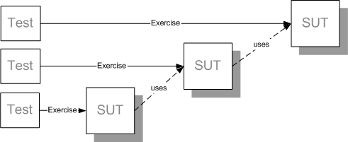
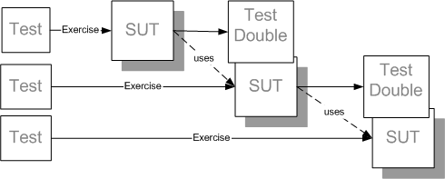
Without and with mocks/test doubles

Slide 13
References
http://www.michaelminella.com/testing/unit-testing-with-junit-and-easymock.html
http://www.easymock.org/EasyMock3_0_Documentation.html
http://jmock.org/getting-started.html

